Slide 1






Amazon Sales Dataset
Faisal Abdulaziz Alkhuraif
Khafuq Abdullah Altheyab

Slide 2
Made By
Faisal Alkhuraif
Khafuq Abdullah Altheyab
Amazon Sales Dataset

Slide 3

this dataset provides a comprehensive overview of amazon sales from April to July.
covering a variety of products. Using this dataset, retailers and digital marketers can measure the performance of their campaigns more accurately and efficiently.

Slide 4
Dataset contains:
24 Columns
120,000 rows
index
Order ID
Date
Status
Fulfilment
Sales Channel
ship-service-level
Style
SKU
Category
Size
ASIN
Courier Status
Qty
currency
Amount
ship-city
ship-state
ship-postal-code
ship-country
promotion-ids
B2B
fulfilled-by
Unnamed: 22

Slide 5
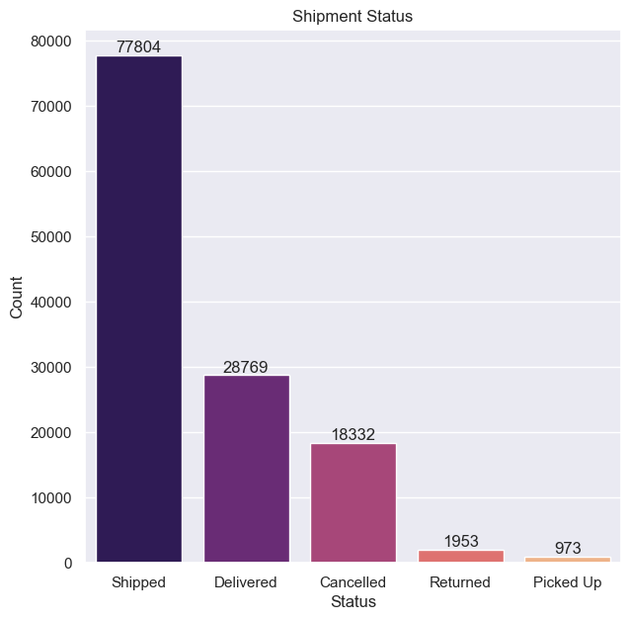
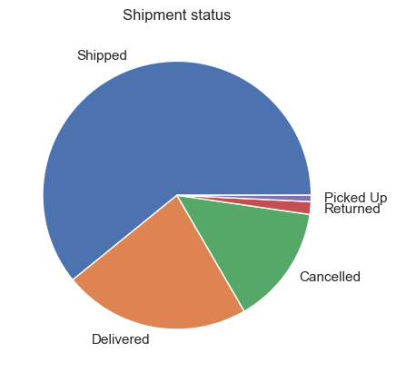
Charts Based on Shipment Status

Slide 6
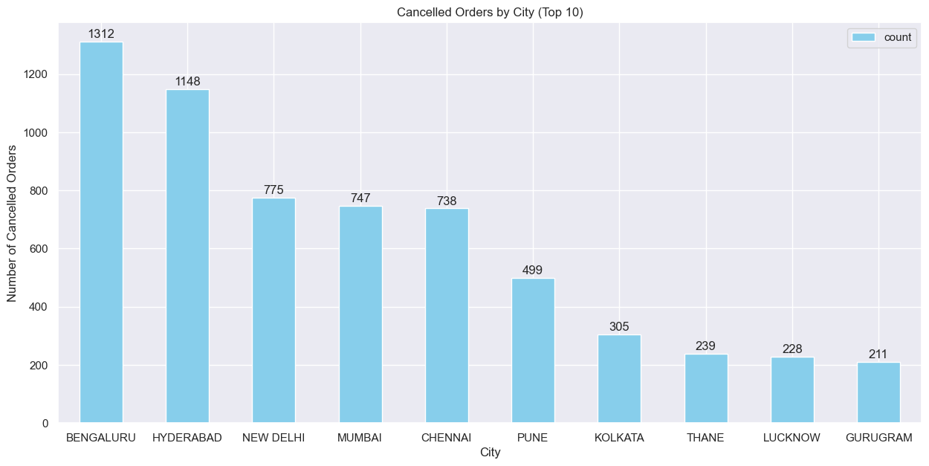
CANCELLED ORDERS COUNT

Slide 7
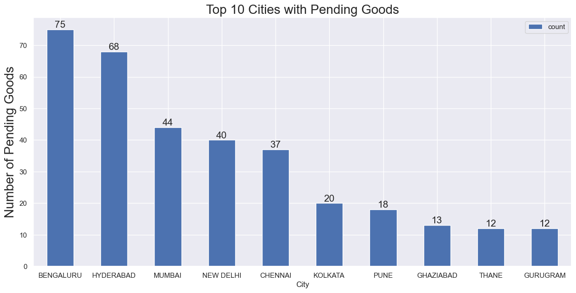
PENDING ORDERS COUNT

Slide 8
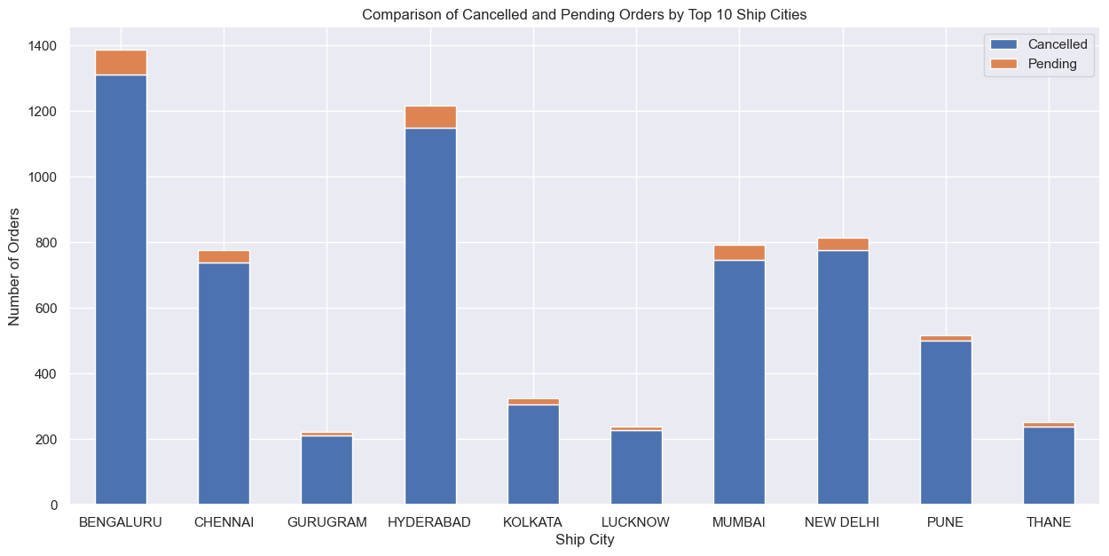
What do we notice here ?

Slide 9
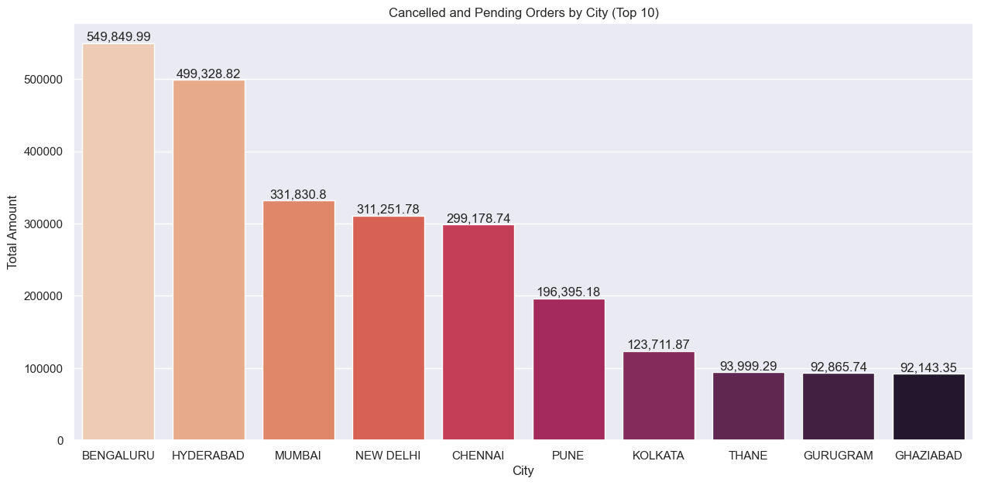

Slide 10
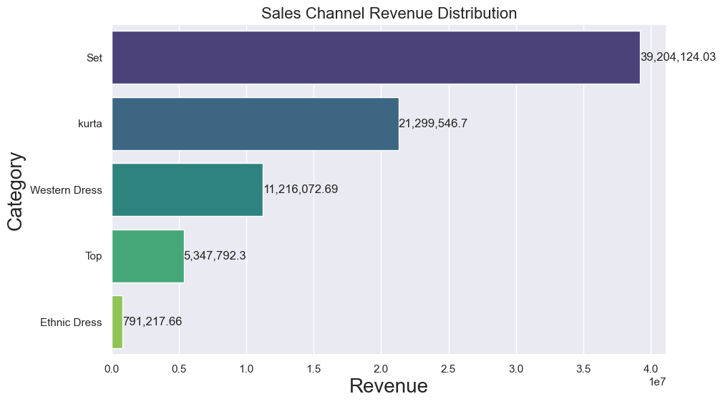
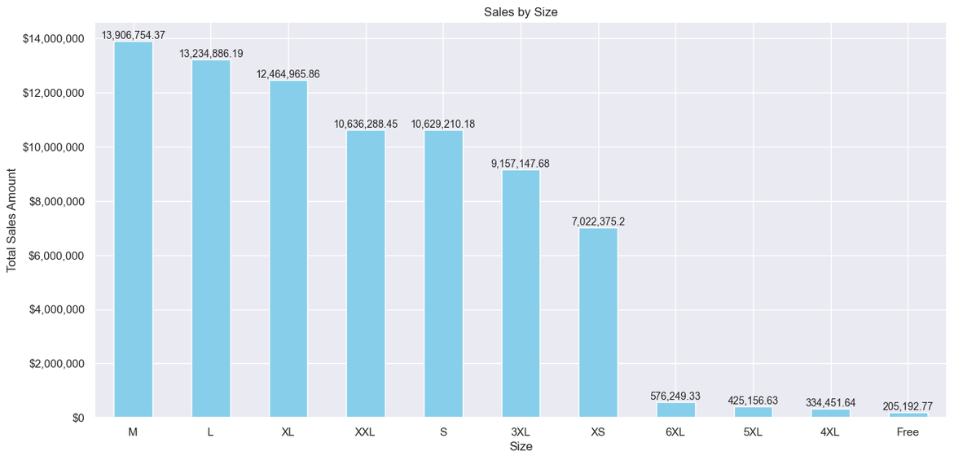
Mean, median and range

Slide 11
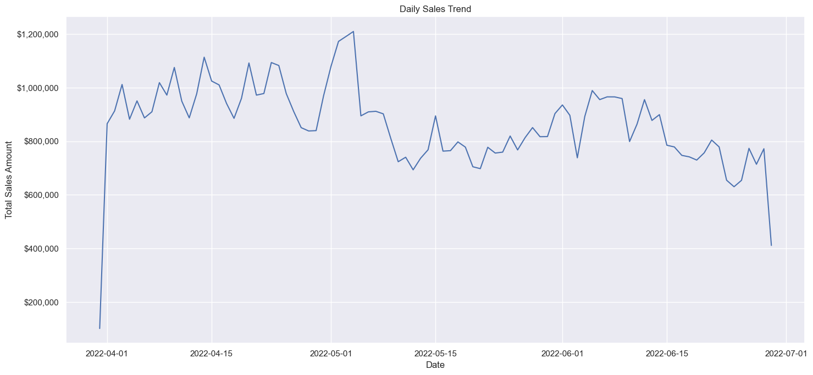
Daily Sales Trend

Slide 12
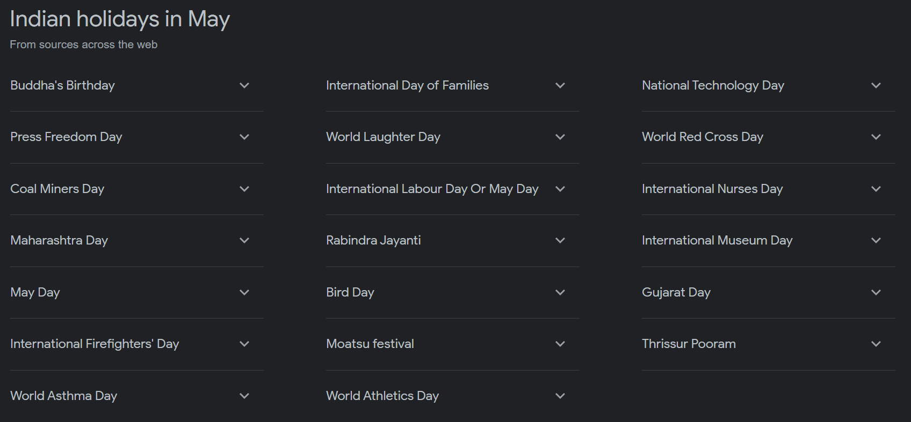
What was the reason for that peak in May ?

Slide 13
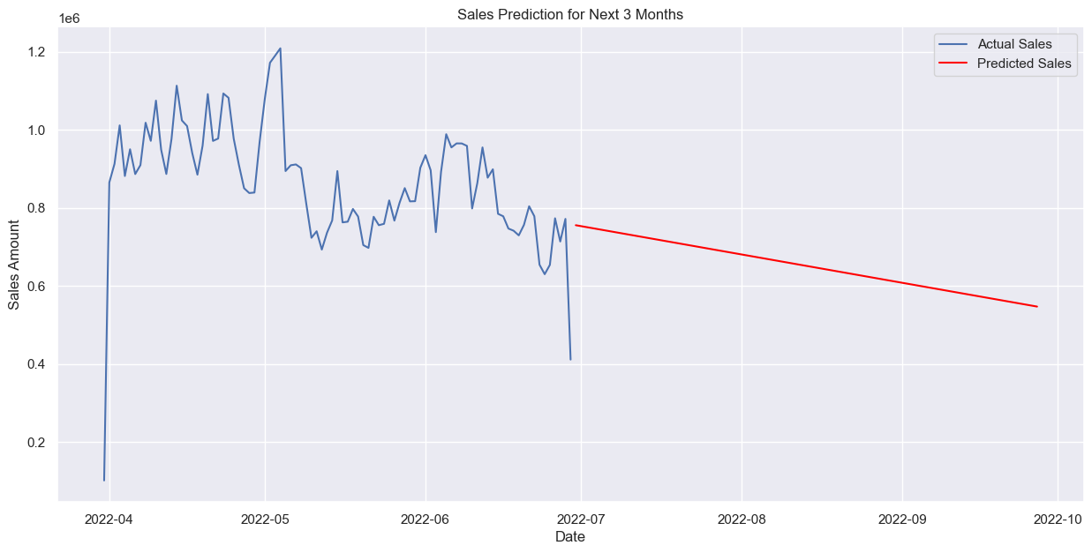
Daily Sales Trend

Slide 14
Thank you all

